Slide 1
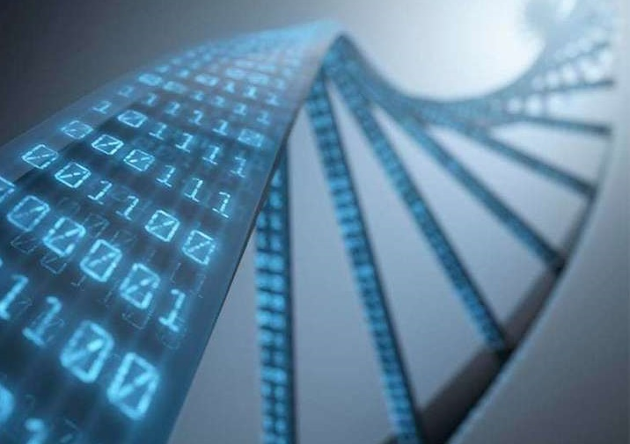

Data Carpentry: Enabling Researchers to Work More Effectively with Data @datacarpentry @thecarpentries http://www.datacarpentry.org

Slide 2
General overview
Introductions of instructors and attendees
Logistics
Data Carpentry Genomics!

Slide 3
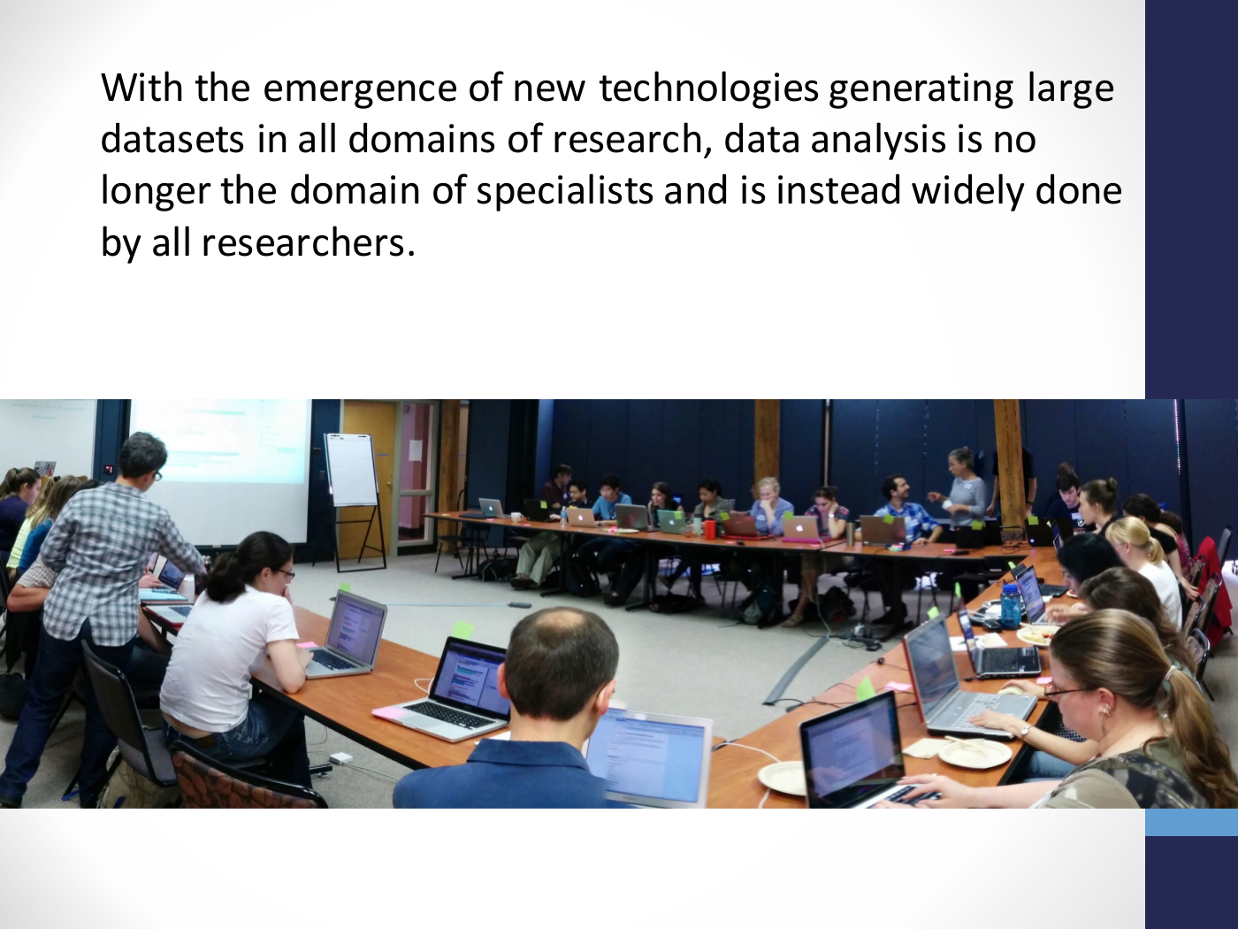

Slide 4
Bioinfo training gap
Attwood, T.K. et al. Briefings in Bioinformatics, 2017, 1-7

Slide 5
Sentiments on data within the NSF BIO Center
I'm having a hard time analyzing microarray, SNP or multivariate data with Excel and Access.
I want to use public data.
I'm interested in going in to industry and companies are asking for data analysis experience.
I'm trying to reboot my lab's workflow to manage data and analysis in a more sustainable way.
I'm re-entering data over and over again by hand and know there's a better way.
I have overwhelming amounts of data.
I'm tired of feeling out of my depth on computation and want to increase my confidence.

Slide 6
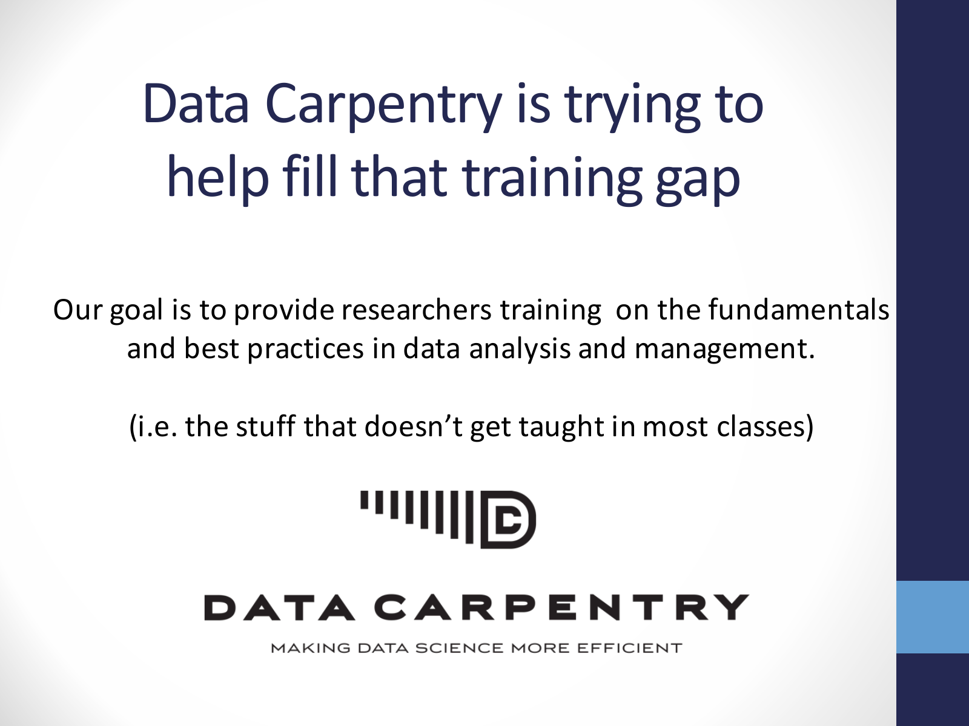

Slide 7
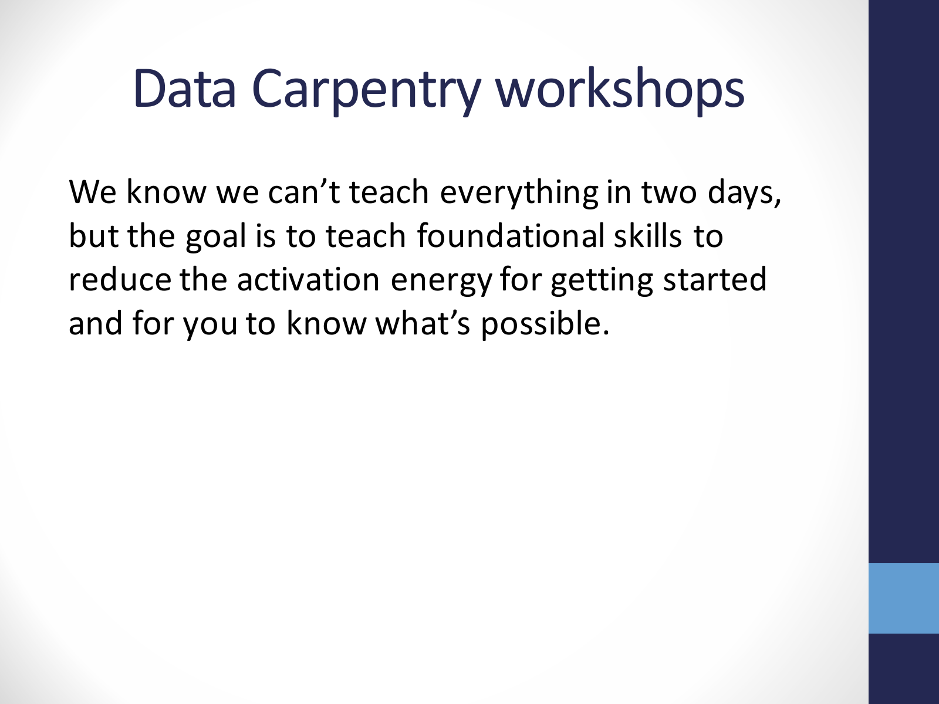

Slide 8
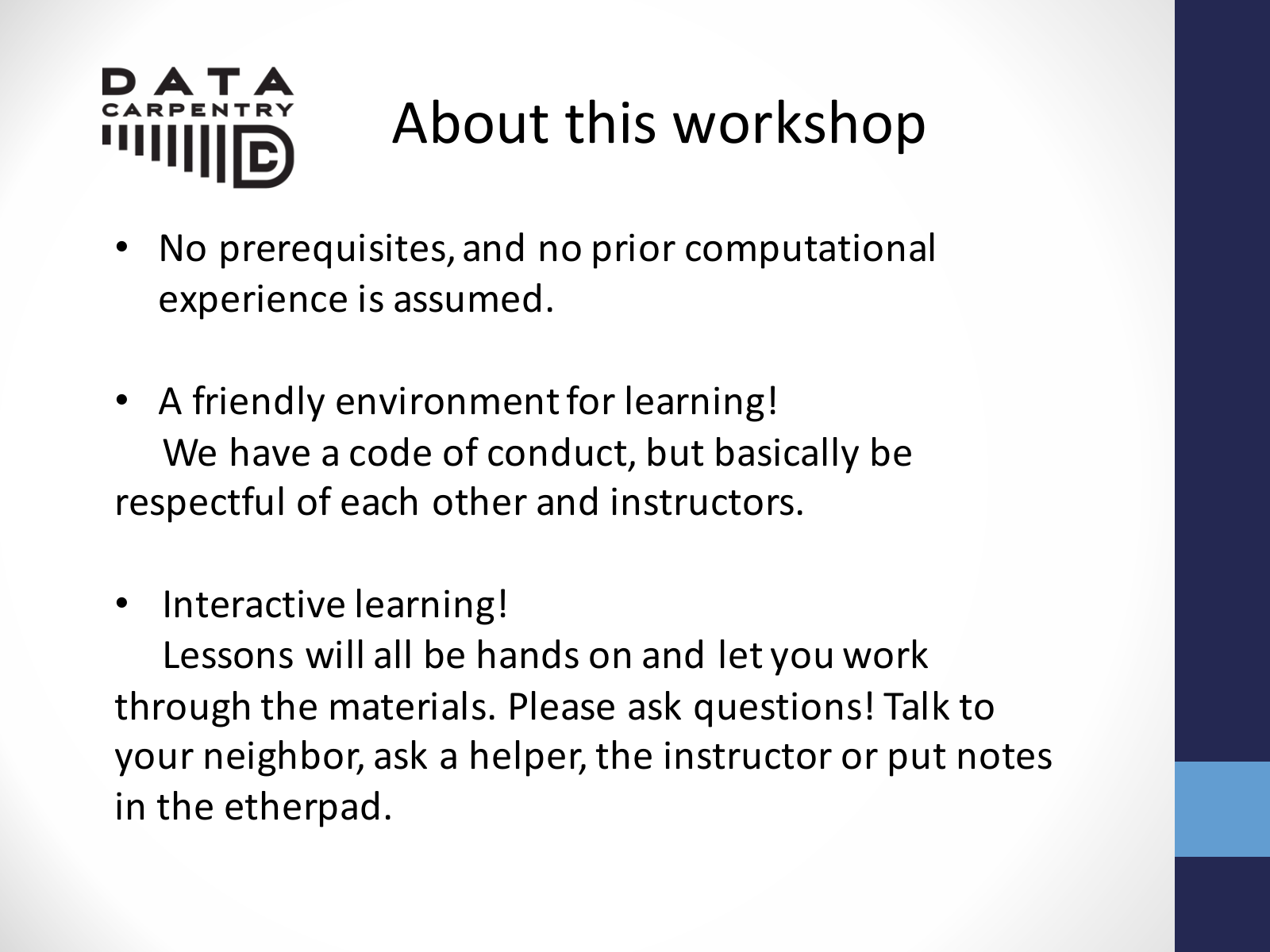

Slide 9
Hello!
Instructors
Catalina Anghel (Canadian Nuclear Labs)
Ahmed Hasan (UTM Dept. of Cell and Systems Biology)
Heather Gibling (Ontario Institute for Cancer Research and UofT Dept. of Molecular Genetics)
Helpers
Centre for Addiction and Mental Health
Marcia Hon
Ricardo Harripaul
Arin Bakht

Slide 10
Before we start
Website: https://canghel.github.io/2018-05-22-camh/
Links to lessons
Etherpad: http://pad.software-carpentry.org/2018-05-22-camh
Online discussion forum
Add links, get help with questions, copy code into window

Slide 11


Sticky notes

Slide 12


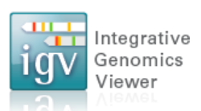
Other things…
Software installation: Grab one of us at coffee break if you had any problems!
Bathrooms
Breaks
Can see screen?
Windows: Putty

Slide 13
Acknowledgements
Slides adapted from:
Jason J Williams: https://github.com/JasonJWilliamsNY/2017-08-28-nmsu/blob/gh-pages/DataCarpentry_Intro.pdf
Erica Mudrak, https://github.com/emudrak/2017-06-14-cornell/tree/gh-pages/slides
Images
http://acobiom.com/bioinformatics/

